Slide 1
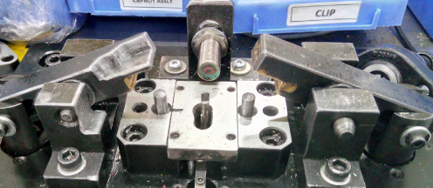
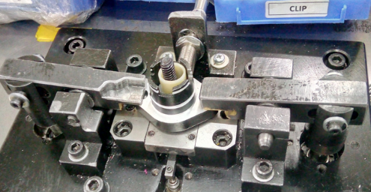
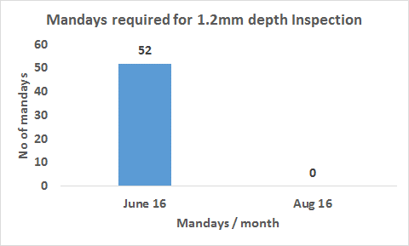
P15
TPM CIRCLE NO :- 3
ACTIVITY
KK
QM
PM
JH
SHE
OT
DM
E&T
KAIZEN IDEA SHEET
TPM CIRCLE NAME : P15 TEAM
LOSS NO. / STEP
DEPT :- Assembly
RESULT AREA
P
Q
: A
C
D
S
M
B
CELL :-A128
CELL NAME:- Tensioner
MACHINE / STAGE :- A534 Assembly Line
OPERATION :- Rewinding
KAIZEN THEME : To save manpower required for 1.2 mm depth checking in A534 / A319 Tensioner.
IDEA :- Internal Gauging
COUNTERMEASURE:- Gauge accommodated in winding operation fixture
BENCHMARK
52 man days / month
PROBLEM / PRESENT STATUS :- 2 man days required to for 1.2mm depth inspection in A534 / A319 Tensioner Assy / day causing 52 man days / month
TARGET
0 No.
KAIZEN START
02.07.2016
Gauge Plunger
KAIZEN FINISH
27.07.2016
TEAM MEMBERS :-
Pramod Kardile
2. Samadhan Bankar
TEAM MEMBERS :-
20 k Rs. Per month saved.
Inspection accuracy increased.
In-house rejection due to 1.2mm depth variation eliminated.
KAIZEN SUSTENANCE
Manual Dial Gauge
Gauge within Fixture
WHAT TO DO: Calibration of gauge with reference to Master
HOW TO DO: Check point added in poka yoke verification sheet
FREQUENCY : Daily
BEFORE
AFTER
WHY - WHY ANALYSIS :-
Why1: 2 man days required.
Why2: Separate stage for 100% inspection.
Why3: Man operated gauging for 100% inspection.
Why4: Process designed with external gauging.
RESULT :-
SCOPE & PLAN FOR HORIZONTAL DEPLOYMENT
Sr No | CELL | TDC | RESP. | STATUS
1 | Total 7 cells | 20/4/17 | Samadhan | On-going
ROOT CAUSE :- Process designed with external gauging
Inspection stage elimination saved cost of 52 inspectors / month.
REGISTRATION NO. & DATE: 25.07.16
REGISTERED BY :- Mohan kate
MANAGER’S SIGN :- Sandeep patil

